Slide 1
Chongqing University of Technology
ATAI
Advanced Technique of Artificial Intelligence
Chongqing University of Technology
Xiao Chen¹, Changlong Sun², Jingjing Wang^{1,∗}, Shoushan Li¹,
Luo Si², Min Zhang¹, Guodong Zhou¹
¹School of Computer Science and Technology, Soochow University, China
²Alibaba Group, China
Aspect Sentiment Classification with Document-level Sentiment Preference Modeling
——ACL 2020
2020.12.28 • ChongQing
Reported by Sijin Liu

Slide 2
Chongqing University of Technology
ATAI
Advanced Technique of Artificial Intelligence
Chongqing University of Technology
1.Introduction
2.Method
3.Experiments
4.Conclusion

Slide 3
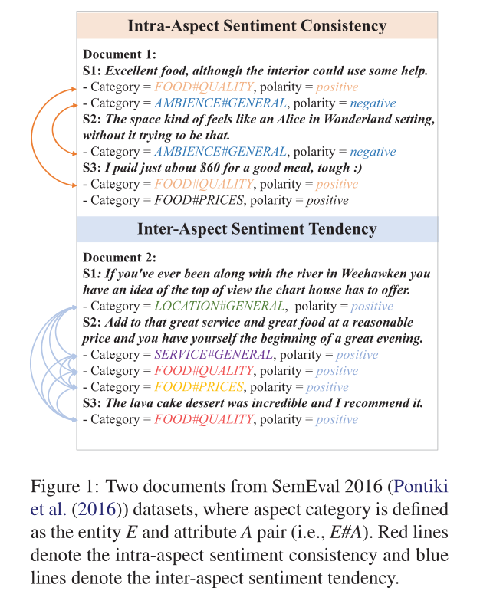
Introduction
All the previous studies ignore the document-level sentiment preference information, which can be leveraged to effectively mitigate the information deficiency problem in ASC.
Different from all the past studies, this paper proposes a novel Cooperative Graph Attention Networks approach to capture the document-level sentiment preference information in ASC.
Notes:
Aspect：picture quality
Polarity：positive
Aspect：battery life
Polarity：negative

Slide 4
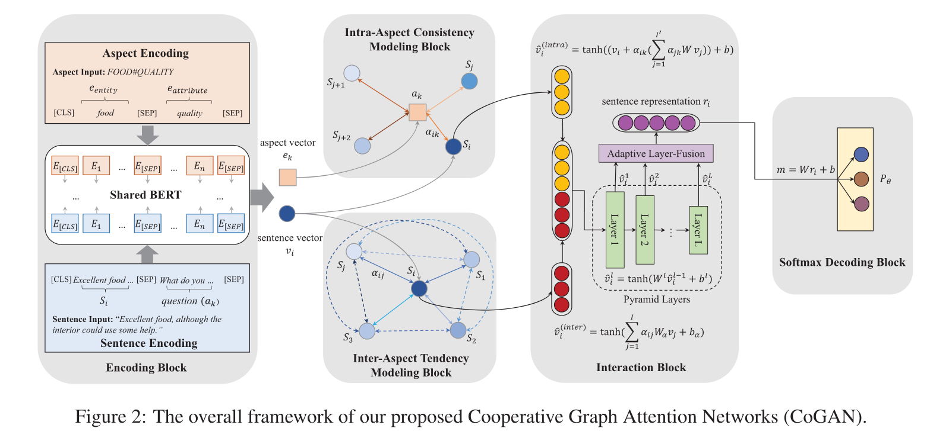
Method

Slide 5
Method
Encoding Block
Aspect Encoding
Sentence Encoding

Slide 6
Method
Intra-Aspect Consistency Modeling Block
Inter-Aspect Tendency Modeling Block

Slide 7
Method
Interaction Block
Pyramid Layers
Adaptive Layer-Fusion
Softmax Decoding Block

Slide 8
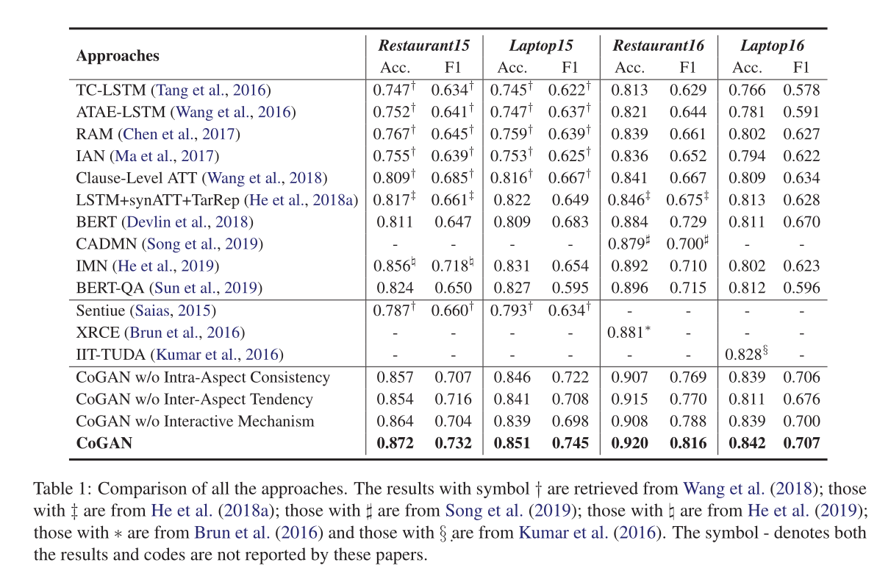
Experiments

Slide 9
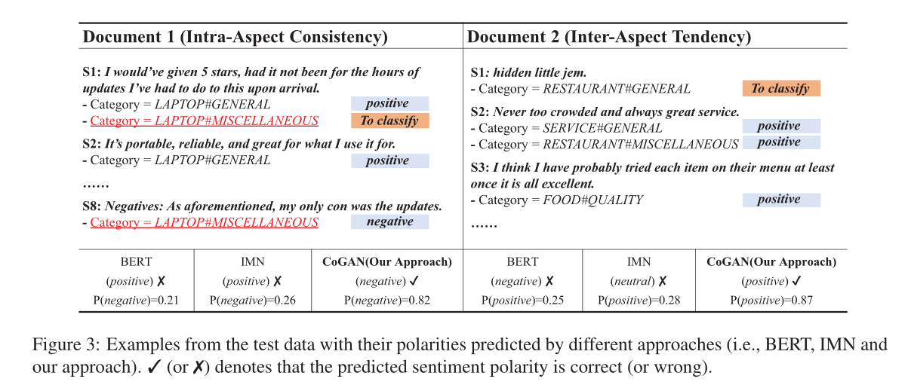
Experiments

Slide 10
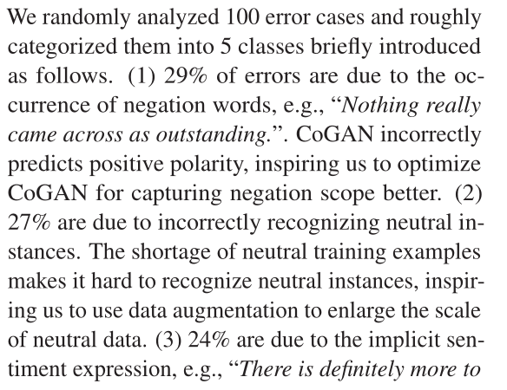
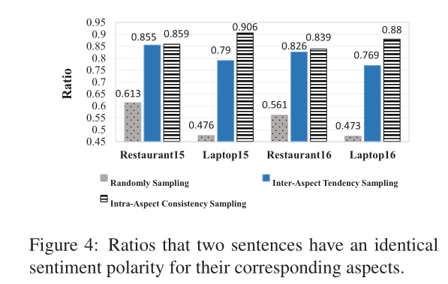
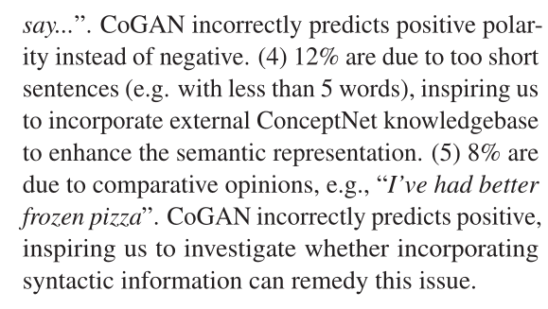
Experiments

Slide 11
Summary
In this paper, we propose a novel CooperativeGraph Attention Networks (CoGAN) approach to Aspect Sentiment Classification (ASC). The main idea of the proposed approach is to incorporate two kinds of sentiment preference information (i.e., the intra-aspect consistency and inter-aspect tendency) in a document for remedying the information deficiency problem in ASC. Experimental results on four datasets from SemEval-2015 and 2016 demonstrate that our approach significantly outperforms number of competitive baselines, including all the three best-performed systems in the shared tasks of both SemEval-2015 and 2016.

Slide 12
Thank you!

